Slide 1
Career Planning
Career Planning is an ongoing process of structured self-analysis which involves four main steps in order to identify career objectives, marketable skills, strengths and weaknesses.
  Self analysis: Finding out where you are currently in your career versus where you would like to be in the future. Also, taking an inventory of the skills you have to offer, as well as your values and interests.
  Research: Exploring occupations and areas that interest you. Once you have a list of your interests, compare your current skills with those required for the jobs that interest you and decide how they match up.
  Decision making: Narrow down the list of possible career options by determining what best suits you at this point in time.
  Taking action: Define your next steps figure out where to get the support, training or other skills needed to achieve your current career goals.
Want more best practices? Visit Praxie.com

Slide 2
Career Planning
List your top three career goals, current skills and knowledge, and the skills and knowledge you believe will be needed to achieve your future goals. Based on the difference between your existing and required future skills and knowledge, identify specific learning and development goals you will focus on in one year and in five years to help you move toward to overall career goals.
Top 3 Career Goals
Current Skills and Knowledge | Skills and Knowledge Needed for Future Goals and Opportunities
1 Year Learning & Development Goals | 5 Year Learning & Development Goals
Want more best practices? Visit Praxie.com

Slide 3
Actions
Create an action plan for beginning the process of achieving your learning and development goals. Include other actions focused on achieving your overall career goals.
Actions | Owner | Due Date
Enter action here | Enter owner | Enter due date
Want more best practices? Visit Praxie.com

Slide 4
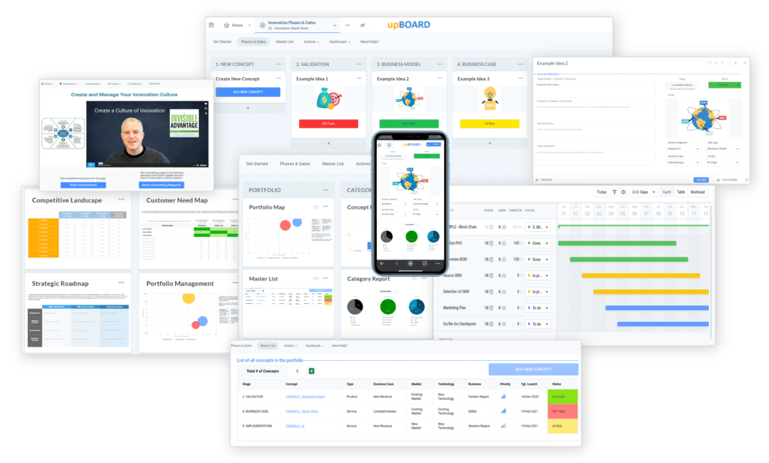

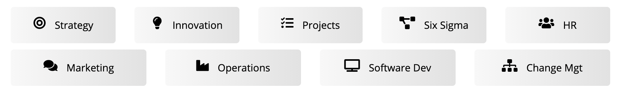
www.praxie.com
Learn, Configure & Run Business Best Practice Applications in Minutes.
Want more best practices? Visit Praxie.com

