Slide 1
Competency Based Interviewing Template
Competency Based Interviewing is a style of interviewing used to determine an applicant’s ability to handle certain situations. Most questions in this type of interview require the candidate to provide specific examples of how they’ve responded to difficult situations in the past.
Competency Based Interviewing as a technique has been in use for the last thirty years, mostly as a result of many companies using Competency Frameworks in their job descriptions. Competency Based Interviewing is typically used when the interviewer wants to know how the candidate might behave when put in common workplace situations.
Another key feature of Competency Based Interviewing is that the answers are scored against predetermined competencies such as Communication, Teamwork, Leadership or Decision-Making skills.
Want more best practices? Visit Praxie.com

Slide 2
Competency Based Interviewing Template
Update the list of competencies and their descriptions based on your job description. Interview candidates and compare their competencies below.
Interviewed by: |  | Position: | Date:
Competencies | Description | Candidate 1 Name | Candidate 2 Name | Candidate 3 Name | Candidate 4 Name
Ability | Ability to perform to the specified standard
Technical | Demonstrates specific knowledge, skills and qualifications of the position
Behaviors | The personality traits important for successful results in the job
Strengths | Skills and Expertise
Experience | Mastery in any activity gained through exposure to it
Want more best practices? Visit Praxie.com

Slide 3
Actions
Create an action plan for building out your competency based interviewing process including defining competencies for specific job descriptions. Also create action for conducting your interviews and comparing competencies across candidates.
Actions | Owner | Due Date
Enter action here | Enter owner | Enter due date
Want more best practices? Visit Praxie.com

Slide 4
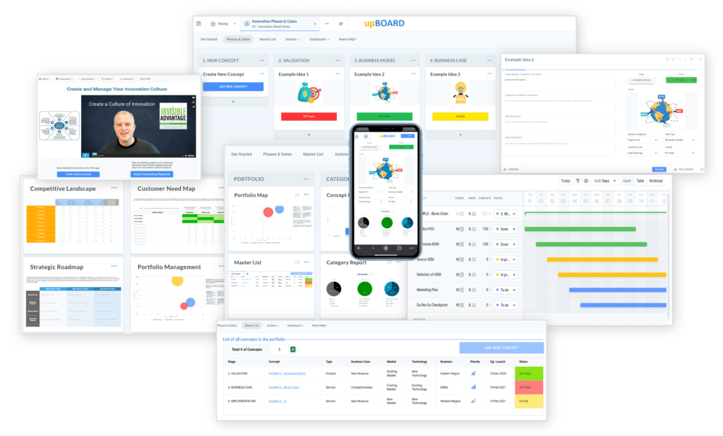

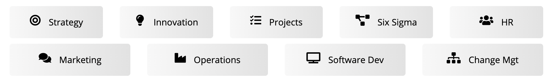
www.praxie.com
Learn, Configure & Run Business Best Practice Applications in Minutes.
Want more best practices? Visit Praxie.com

