Slide 1
Five Forces Model Template
The Five Forces Model, also called Porter’s Five Forces Framework, is a tool for analyzing a business’ competition and competitive environment.
The model looks at five forces within any industry to determine the state of the competitive the environment and as a result, the implications for how profitable the industry could be and business strategies for driving success.
The five forces include:
  Threat of New Entrants
  Bargaining Power of Buyers
  Threat of Substitute Products
  Bargaining Power of Suppliers
  Rivalry Among Existing Competitors
Want more best practices? Visit Praxie.com

Slide 2
Five Forces Framework
Complete the Five Forces by entering your analysis for each dimension of the model.
Threat of New Entrants
Threat of New Entrants | Enter analysis here
Bargaining Power of Buyers | Enter analysis here
Threat of Substitute Products | Enter analysis here
Bargaining Power of Suppliers | Enter analysis here
Rivalry Among Existing Competitors | Enter analysis here
Bargaining Power of Suppliers
Bargaining Power of Buyers
Rivalry Among Existing Competitors
Threat of Substitute Products
Want more best practices? Visit Praxie.com

Slide 3
Actions
Create an action plan for completing your Five Forces Framework, including any research and input needed from key stakeholders or your team. Also include actions based on addressing the implications or strategies that arise from completing your analysis.
Actions | Owner | Due Date
Enter action here | Enter owner | Enter due date
Want more best practices? Visit Praxie.com

Slide 4
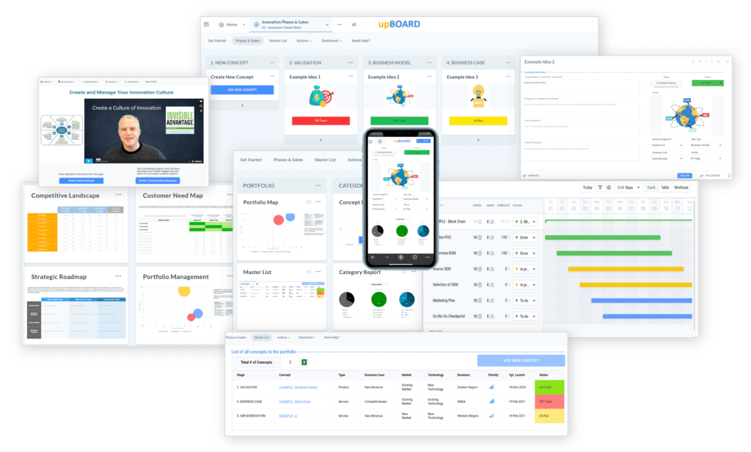

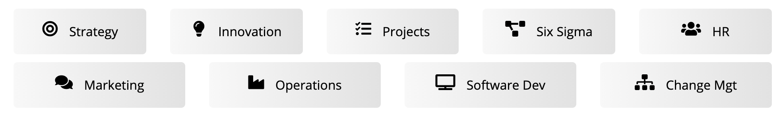
www.praxie.com
Learn, Configure & Run Business Best Practice Applications in Minutes.
Want more best practices? Visit Praxie.com

