Slide 1
Learning and Growth Scorecard
The Learning and Growth Scorecard is a part of the balanced scorecard that refers to intangible assets (e.g., employee skills and abilities) that are required to maintain internal processes in the organization. More broadly, it consists of the companies’ jobs, systems and climate, all three of which are needed to maintain survival. Sometimes improvements made in the learning and growth domain hinder short-term results in service of facilitating long-term progress.
The main function of the learning and growth perspective is to understand how intangible assets drive the major sources of value in the company, consisting of:
  Human capital
  Information capital
  Organizational capital
Want more best practices? Visit Praxie.com

Slide 2
Learning and Growth Scorecard Template
For each dimension below, list what’s needed to ensure successful implementation of your business strategy.
Human Capital | Information Capital | Organizational Capital
List the human knowledge, skills, abilities and other characteristics needed to carry out the business strategy | List the information systems, networks and infrastructure needed to carry out the business strategy | List the actions needed for the organizational climate in order to ensure alignment with the business strategy.
Want more best practices? Visit Praxie.com

Slide 3
Actions
Create an action plan for developing and validating your list of priorities with your team and organization. Capture additional actions focused on implementing your top priorities for each Learning and Growth area.
Actions | Owner | Due Date
Enter action here | Enter owner | Enter due date
Want more best practices? Visit Praxie.com

Slide 4
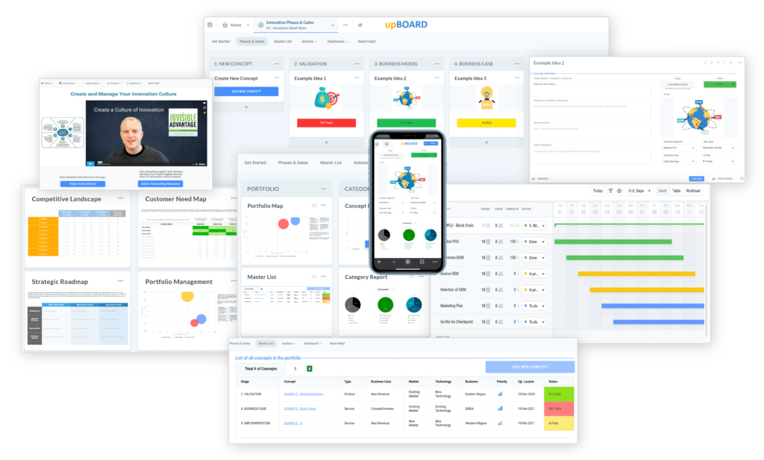

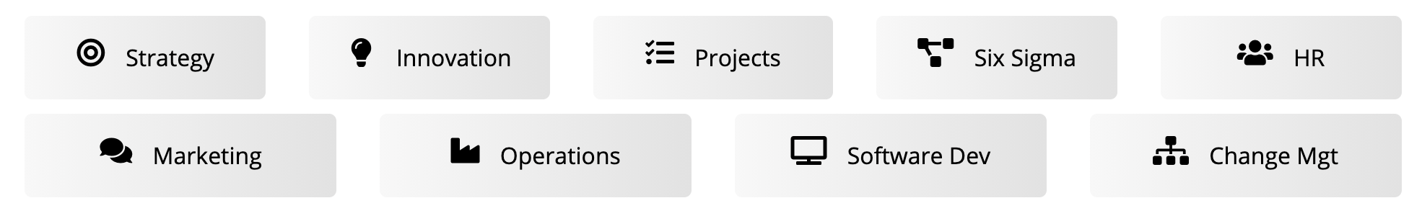
www.praxie.com
Learn, Configure & Run Business Best Practice Applications in Minutes.
Want more best practices? Visit Praxie.com

