Slide 1
Mentoring Action Planning
Mentoring is the act of providing guidance in the workplace to a less-experienced employee, called a mentee. A mentor may either be another employee of the company or a professional from outside of the company. The mentor is a role model who shares knowledge and advice to help the employee grow professionally.
The benefits of having a Mentor for the employee are numerous, and include:
Having someone with greater knowledge and experience to turn to for advice. While a mentor won’t do the employee’s job he or she can provide guidance on how to complete a certain task, help the employee in problem-solving, or critique the employee’s work.
A mentorship may help an employee feel less isolated at work and assist in helping with his or her interaction with others.
A mentor can provide an employee with tips on career growth and introduce the employee to other professionals who can help with career growth.
As the employee matures in their career, a mentor may remain a valued adviser to the employee
Want more best practices? Visit Praxie.com

Slide 2
Mentoring Action Planning
Use template to summarize and track those you are mentoring.
Mentee Name
Org, Dept, Group | Enter org, dept or group name
Title | Enter title
Email | Enter email
Phone | Enter contact no
Development Goals
1.
2.
3.
4.
Progress Summary
Discussion Date | Goal for Next Meeting | Date of Next Meeting
Want more best practices? Visit Praxie.com

Slide 3
Actions
Create an action plan focused on managing and developing your mentees.
Actions | Owner | Due Date
Enter action here | Enter owner | Enter due date
Want more best practices? Visit Praxie.com

Slide 4
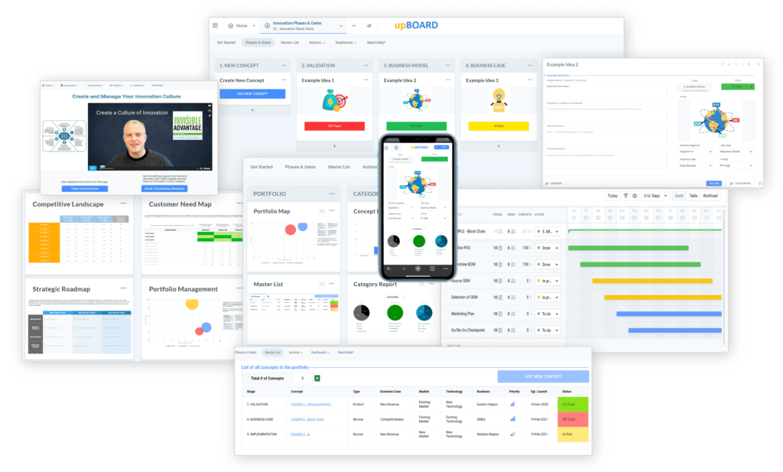

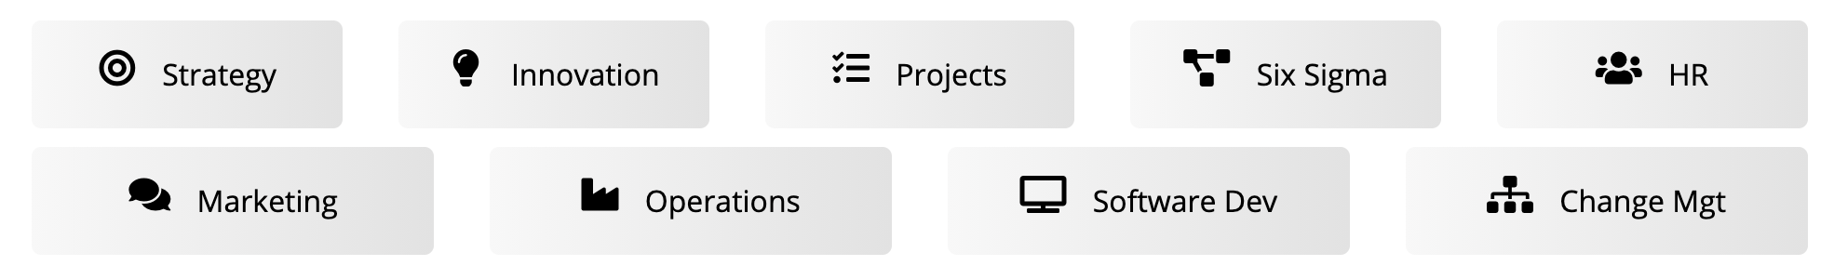
www.praxie.com
Learn, Configure & Run Business Best Practice Applications in Minutes.
Want more best practices? Visit Praxie.com

